Slide 1
Social NFT Marketplace
A visionary investment in crypto world
Name: Aman Kumar
Roll No: 2001331530027
Course: B Tech CSE AI&ML
Guide Name : Ms. Neelam Bidhuri

Slide 2
INTRODUCTION
NFT Marketplace is an internet based commercial center where craftsmen sell their multifaceted craftsmanship and where purchasers can get to it utilizing digital currency, like Bitcoin.
Non-fungible tokens (NFTs) are digital assets that are unique and cannot be replaced.
NFTs can represent anything from art to music to in-game items.
Social NFT marketplaces are platforms that allow users to buy, sell, and trade NFTs.
These marketplaces offer a number of benefits, including:
Increased liquidity: Social NFT marketplaces make it easier for users to find buyers and sellers for their NFTs.
Reduced fees: Social NFT marketplaces typically charge lower fees than traditional NFT marketplaces.
Increased security: Social NFT marketplaces often have more robust security measures than traditional NFT marketplaces.

Slide 3
Literature survey
Bolton, R. N., & Cora, A. (2021). The future of art collecting: Non-fungible tokens (NFTs) and the transformation of the art market. Journal of Cultural Economics, 45(3), 277-296.
Kietzmann, J., Valkenburg, P. M., & Hermkens, K. (2020). The future of marketing: From transactions to relationships to value co-creation. Journal of Marketing, 84(6), 1-19.
Whitaker, Z., Soh, K., & Teo, H. H. (2021). Non-fungible tokens (NFTs): A literature review and research agenda. International Journal of Information Management, 56, 102394.
Atzori, M., Casares, M., & Perony, N. (2019). Blockchain technology and decentralized applications: A systematic literature review and research agenda. Symphonya, 3(1), 1-36.
Guo, L., Wang, C., & Chen, L. (2021). A survey on non-fungible tokens. IEEE Access, 9, 103426-103448.

Slide 4
PROBLEM STATEMENT
NFT marketplaces are developed to allow artists to sell their works online and express themselves in the digital space(Lack of Creativity and Expression for Creators).
We analyzed how a normal photo sharing social media website can be converted into a social NFT Marketplace.
The current NFT marketplace is fragmented and lacks a social component.
This makes it difficult for users to find the NFTs they are looking for and to connect with other users who share their interests.
As a result, the NFT market is not as liquid as it could be.

Slide 5
OBJECTIVES
The main objective of the project is to not limit social media to influencer marketing, social interaction, business promotion and many more but to also include a web3 component in social media to make a new marketplace for the NFT marketplace.
It will be as simple as for users to use this application:-
They simply have to login into their account.
Upload their favourite pic to the server.
The code will convert their pic into NFT.
It will be further published in the feed of the people who follow the particular person.
From their onwards, followers can easily like the NFT.
And if they want, they can make a buyout to the NFT as simple as that.

Slide 6
methodology
Initialization of front-end
Smart contract Deployment
Minting NFT

Slide 7
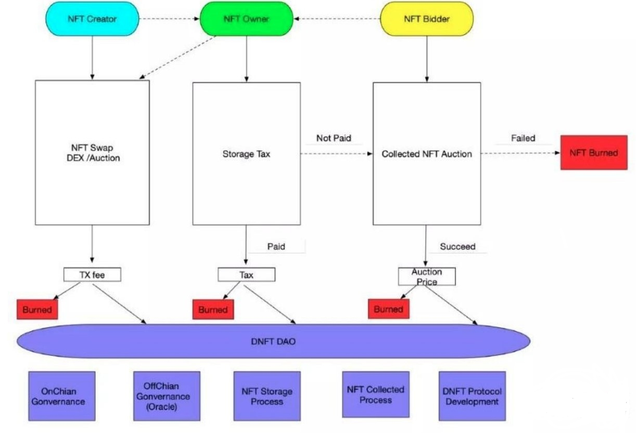
Diagrammatic view

Slide 8
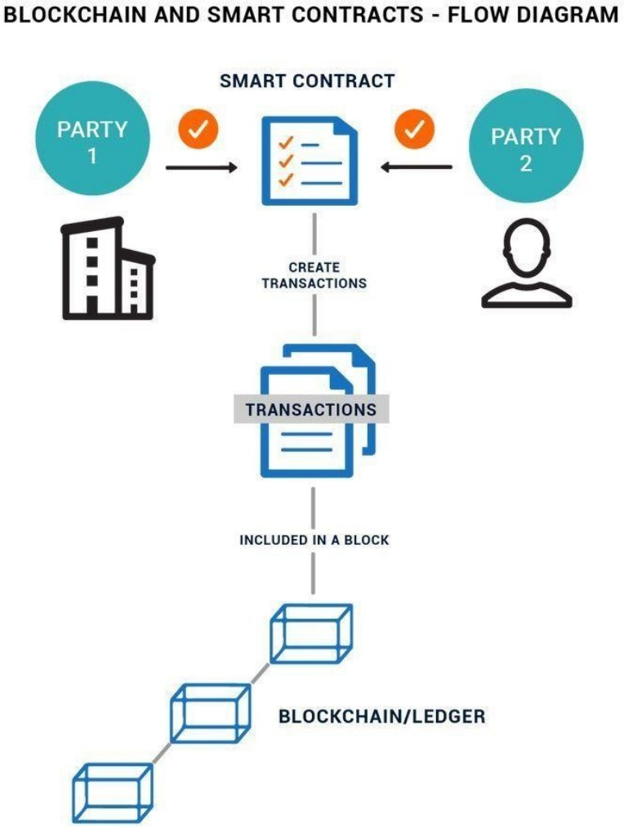

Slide 9
PROJECT DETAILS
NFT (Non-Fungible Token):
A non-fungible token (NFT) is a novel and non-compatible unit of information put away on a blockchain, a type of computerized ledger.
NFTs can be related with reproducible computerized records, for example, photographs, recordings, and sound.
NFTs utilize a computerized record to give a public testament of genuineness or verification of proprietorship, yet don't confine the sharing or duplicating of the hidden computerized documents.
The absence of compatibility (fungibility) recognizes NFTs from blockchain cryptographic forms of money, like Bitcoin.

Slide 10
BLOCKCHAIN WALLET (metamask):
MetaMask is a digital money programming wallet used to interface with the Ethereum blockchain.
It permits clients to get to their Ethereum wallet by means of a program expansion or versatile application, which can then be utilized to collaborate with decentralized applications.
MetaMask permits clients to store and oversee key information, exchange messages, send and get information connected with Ethereum and tokens, and safely interface with explicit applications through a helpful site or an underlying cell phone.

Slide 11
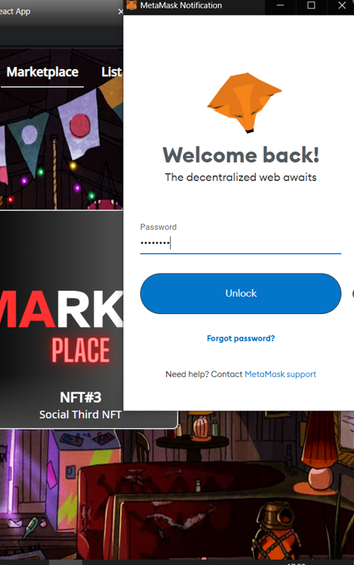
Connecting wallet

Slide 12
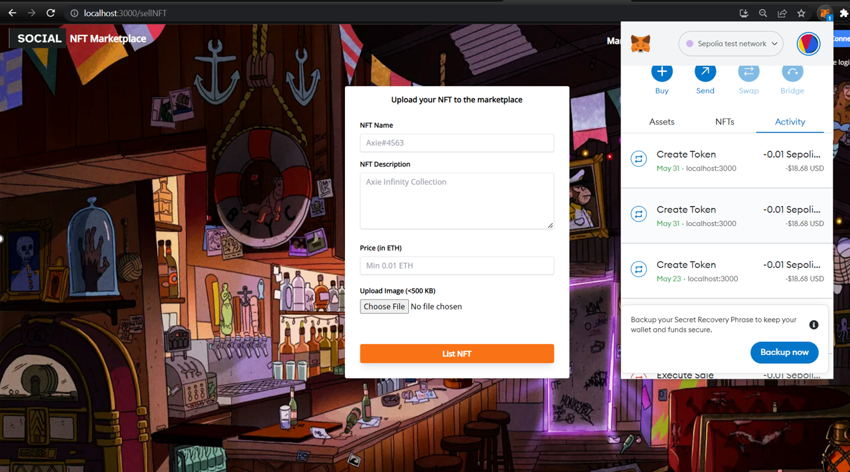
Transaction

Slide 13
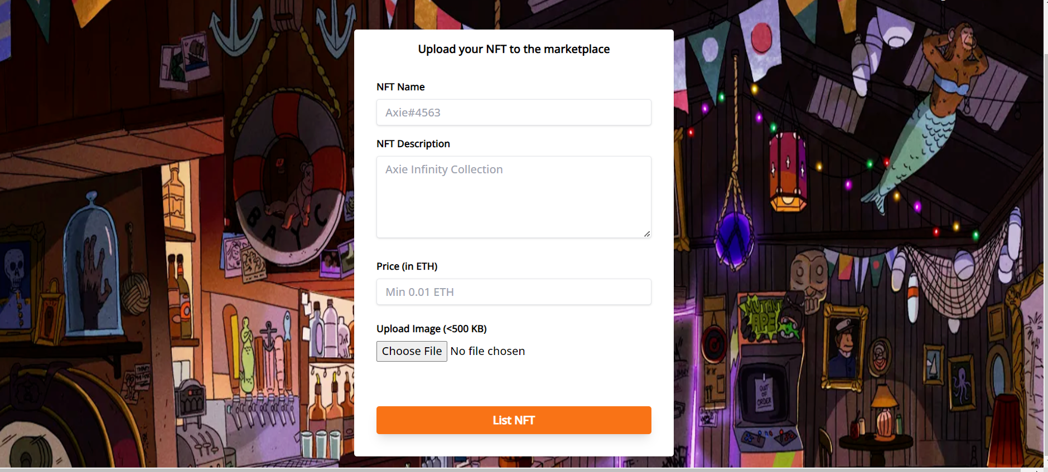
Uploading nft

Slide 14
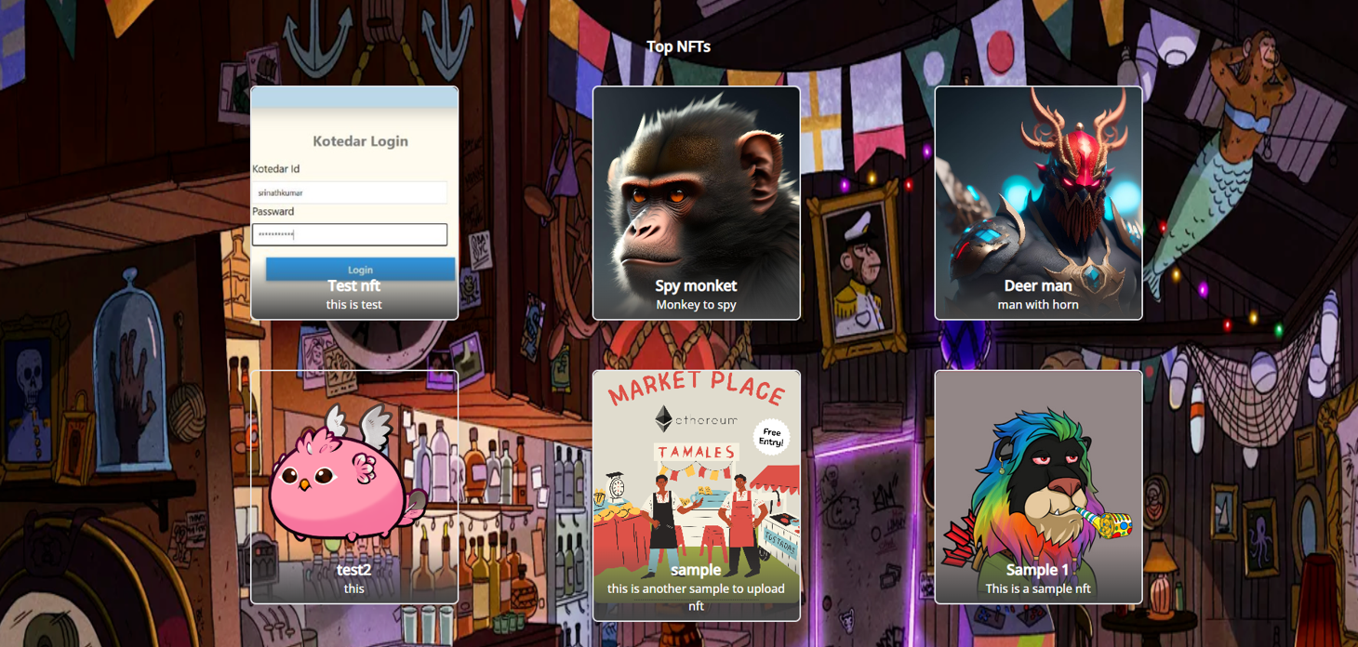
Home page

Slide 15
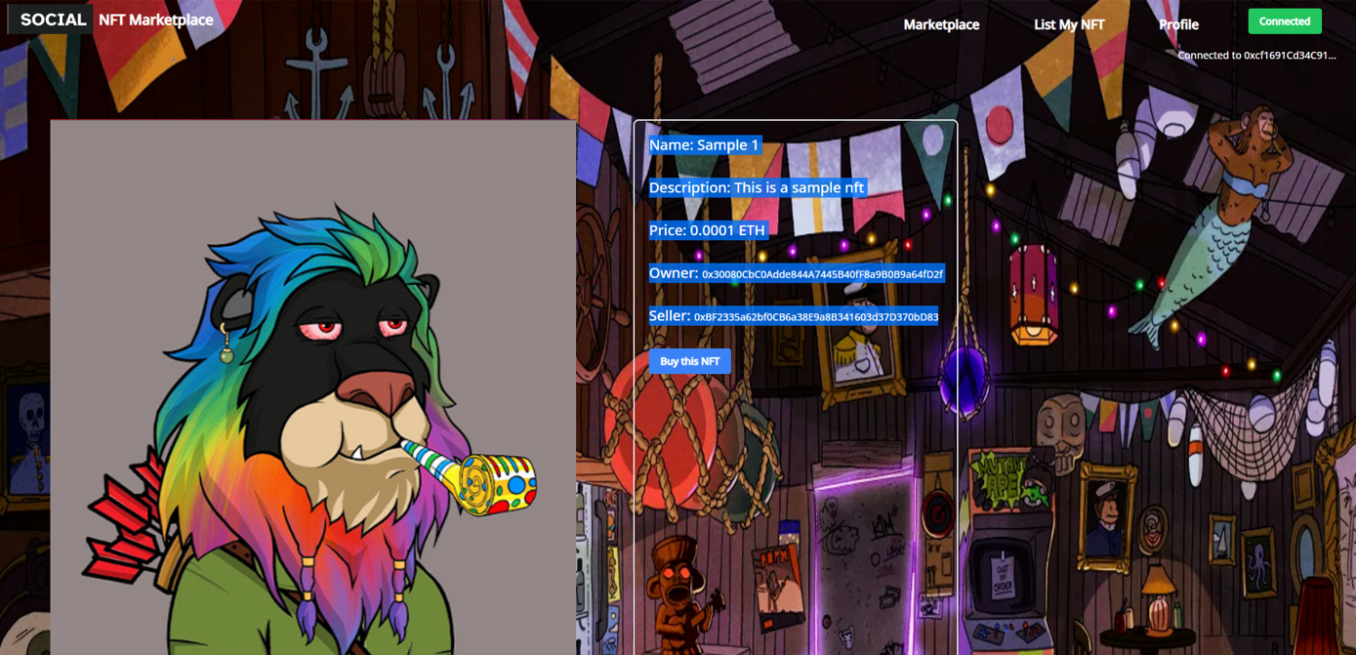
Buying Selected nft

Slide 16
CONCLUSION
They simply have to login into their account.
Upload their favorite pic to the server.
The code will convert their pic into NFT.
It will be further published in the feed of the people who follow the particular person.
From their onwards followers can easily like the NFT.
And if they want they can make a buyout to the NFT as simple as that networking platforms, this goes further to show how relevant and popular social media platforms have become in recent times.

Slide 17
REFERENCE
Bolton, R. N., & Cora, A. (2021). The future of art collecting: Non-fungible tokens (NFTs) and the transformation of the art market. Journal of Cultural Economics, 45(3), 277-296. doi:10.1080/00220216.2021.1930561
Kietzmann, J., Valkenburg, P. M., & Hermkens, K. (2020). The future of marketing: From transactions to relationships to value co-creation. Journal of Marketing, 84(6), 1-19. doi:10.1177/0022242920933276
Whitaker, Z., Soh, K., & Teo, H. H. (2021). Non-fungible tokens (NFTs): A literature review and research agenda. International Journal of Information Management, 56, 102394. doi:10.1016/j.ijinfomgt.2021.102394
Atzori, M., Casares, M., & Perony, N. (2019). Blockchain technology and decentralized applications: A systematic literature review and research agenda. Symphonya, 3(1), 1-36. doi:10.3390/sym3010001
Guo, L., Wang, C., & Chen, L. (2021). A survey on non-fungible tokens. IEEE Access, 9, 103426-103448. doi:10.1109/ACCESS.2021.3063193

Slide 18
THANK YOU

